Slide 1


LCD- 16x2 character display Term Research Project
By: Paul Kafka

Slide 2
Project Description
Task: “Program to implement custom characters like different smiley faces.”
FPGA-based NIOS II system designs of your choice
Nios system?
Hardware Used <picture>

Slide 3
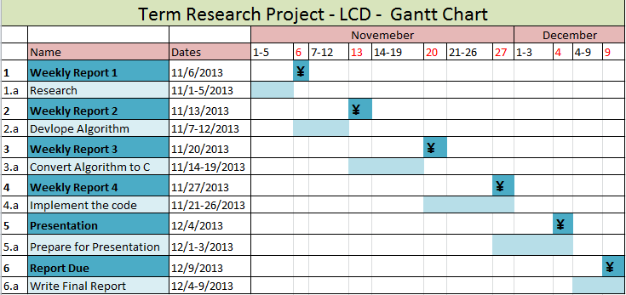
Approach

Slide 4
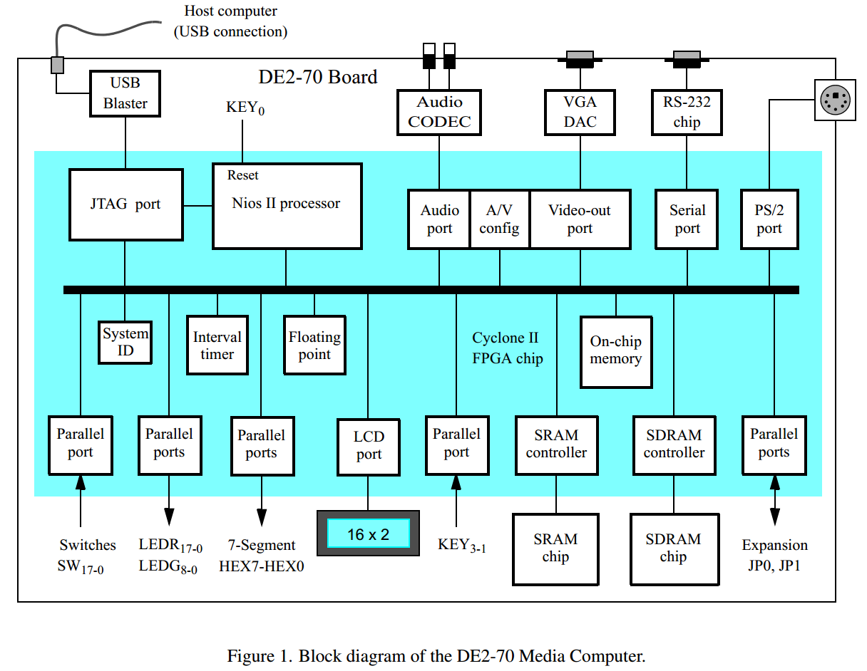
DE2 Media Computer

Slide 5
Research
The DE2-70 Media Computer includes a liquid crystal display (LCD) port that is connected to the 16£2 character display on the DE2-70 board.
The display includes a memory for storing character data
As indicated in Figure 33a, the memory has a total capacity of 40 £2 characters.
Could have used system.h generated files from SOPC Builder or Media Computer provided functions.
Used the media.c to get started
The Character LCD Core sends characters to the LCD according to the Character Generator ROM
Pattern of the LCD
The LCD Core supports a clock frequency of 50 MHz, which is readily available on the DE2/DE1
boards.
The Character LCD Core is a component that can be instantiated by using the SOPC Builder.

Slide 6
Media Computer
Media Computer, is intended to be used for experiments in computer
organization and embedded systems. To support these experiments, the system contains a processor, memory, video
Device
The Altera Nios°R II processor is a 32-bit CPU that can be instantiated in an Altera FPGA chips, and some simple I/O peripherals. Media Computer
includes the Nios II/s version
An easy way to begin working with the DE2-70 Media
Computer and the Nios II processor is to make use of a utility called the Altera Monitor Program, It provides an
easy way to assemble/compile Nios II programs that are written in either assembly language or the C language

Slide 7
LCD Control
The ﬁrst 16 characters stored in each row are visible on
the display, and the remaining 24 characters are not visible at any given time. Each location in the memory can be
accessed by combining the x,y coordinates into a 6-bit address as depicted in Figure 33b. Using this scheme, the top
and bottom rows of the display start at addresses (00)₁₆ and (40)₁₆, respectively, as we show in part a of the ﬁgure.
Instruction register that is used to control the 16£2 character display, and a Data register that is used to send character data to the display
Data can be sent to the display as ASCII character codes, which are automatically converted by the 16x2 character display into bit patterns using a built-in font.
After the location of the cursor has been set, a character can be loaded into this location by writing its ASCII value into the Data register.
As characters are written, the cursor position is
Updated
The line feed character (\n) moves the cursor down one line and to the left-most column
The LCD controller is an output-only device. Therefore, attempts to read from it
returns immediately indicating that no characters have been received.

Slide 8
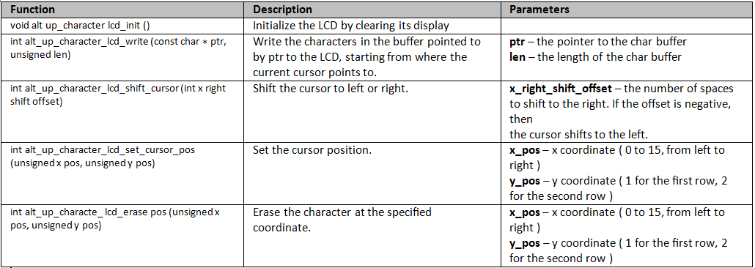
LCD Functionality
The LCD Controller is packaged with C functions accessible through SOPC Builder-generatded SDK.
To use the functions, you must have
#include “alt_up_character_lcd.h”

Slide 9
Software Files
The LCD controller is accompanied by the following software files. These files define
the low-level interface to the hardware and provide the HAL drivers. Application
developers should not modify these files.
■ altera_avalon_lcd_16207_regs.h — This file defines the core's register map,
providing symbolic constants to access the low-level hardware.
■ altera_avalon_lcd_16207.h, altera_avalon_lcd_16207.c — These files implement
the LCD controller device drivers for the HAL system library
BSP>drivers>inc
BSP>drivers>src
System.h
/* * lcd configuration * */#define ALT_MODULE_CLASS_lcd altera_avalon_lcd_16207#define LCD_BASE 0x1901070#define LCD_IRQ -1#define LCD_IRQ_INTERRUPT_CONTROLLER_ID -1#define LCD_NAME "/dev/lcd"#define LCD_SPAN 16#define LCD_TYPE "altera_avalon_lcd_16207"

Slide 10
Register Map
The HAL device drivers make it unnecessary for you to access the registers directly.
Therefore, Altera does not publish details about the register map. For more
information, the altera_avalon_lcd_16207_regs.h file describes the register map, and
the Dot Matrix Character LCD Module User's Manual from Optrex describes the register
usage.
Interrupt Behavior
The LCD controller does not generate interrupts. However, the LCD driver's text scrolling feature relies on the HAL system clock driver, which uses interrupts for timing purposes.

Slide 11
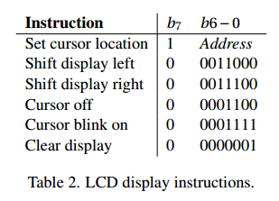
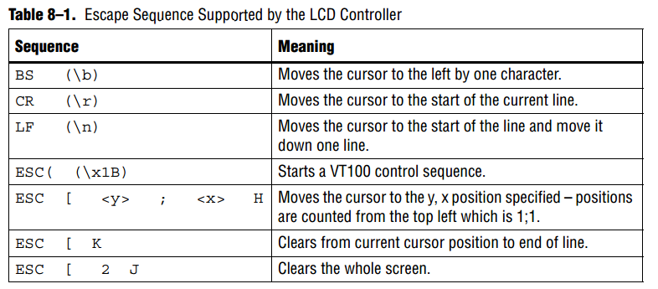
Other Info
The LCD driver supports a small subset of ANSI and VT100 escape sequences that can
be used to control the cursor position, and clear the display as shown

Slide 12
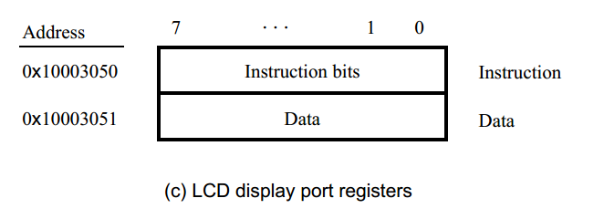
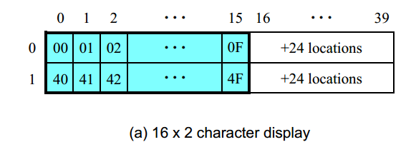
Data -Index for the LCD Character
Generator ROM

Slide 13
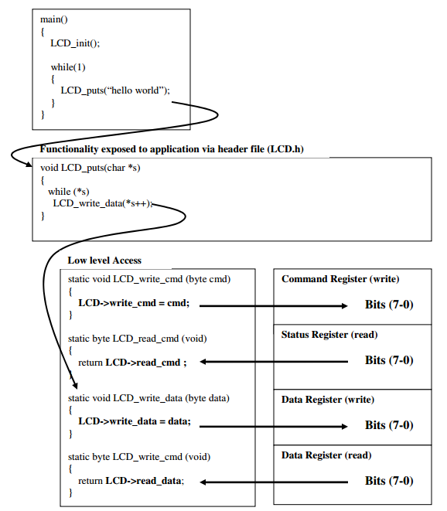

Slide 14
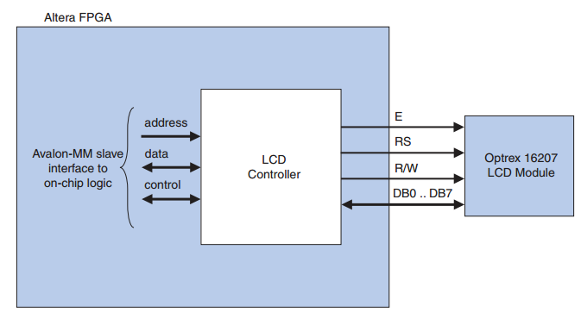
LCD Controller Block Diagram
The LCD controller drivers support the Nios II processor. You can add the LCD controller core from the System Contents tab in SOPC Builder.
Altera provides HAL system library drivers for the Nios II processor that enable you to access the LCD controller using the ANSI C standard library functions

Slide 15
Initialization
The LCD display port automatically initializes and conﬁgures the 16£2 character display when the DE2-70 Media Computer is reset.

Slide 16
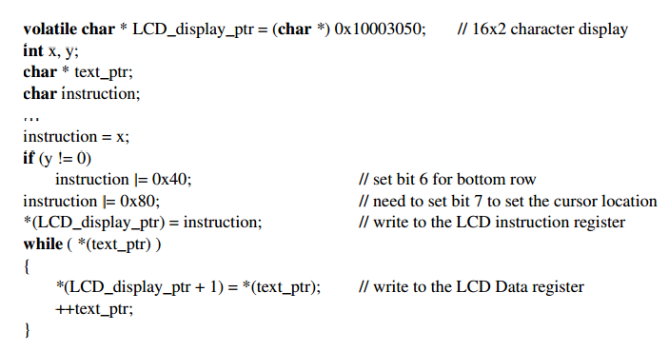
Code

Slide 17
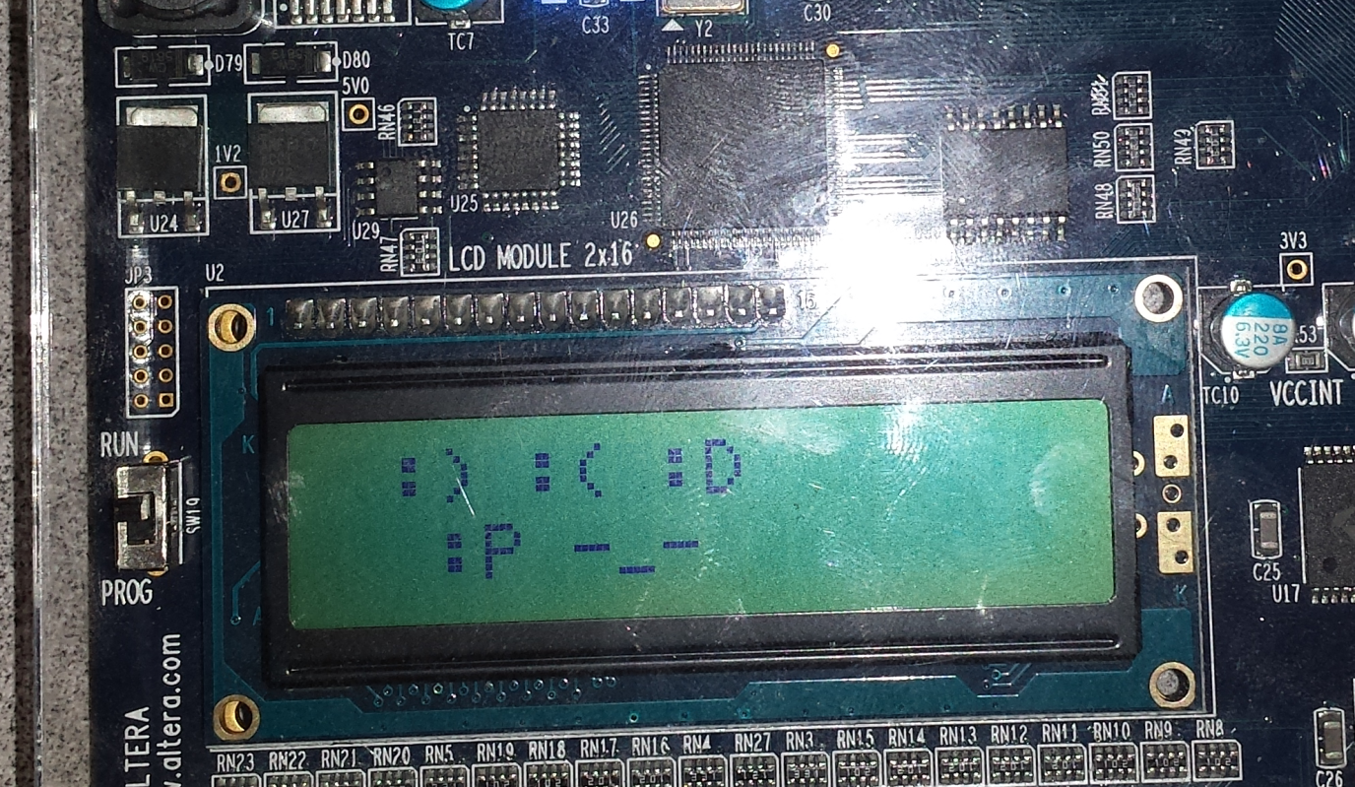
Outcome

Slide 18
Conclusion
What I learned
*(LCD_display_ptr + 1) = ‘h’;
*(LCD_display_ptr + 1) = (char)h;
*(LCD_display_ptr + 1) = 0x1101000 hexnumber ;
char flags = 0;
flags = flags | 0x08;

